Slide 1


PYTHON
Lecture 8

Slide 2

Today’s Agenda
Variables And Memory Management
How Variables In Python Are Different Than Other Languages ?
Immutable And Mutable
Python’s Memory Management
The id( ) Function
The is Operator

Slide 3
Understanding Python Variables
A variable can be seen as a container to store certain values.
While the program is running, variables are accessed and sometimes changed, i.e. a new value will be assigned to a variable

Slide 4
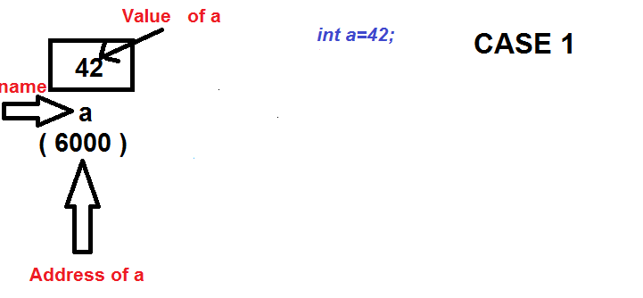
How Variables Work In C ?
In C language when we declare a variable and assign value to it then some space is created in memory by the given name and the given value is stored in it.
Suppose we write the statement int a=42; , then the following will be the memory diagram.

Slide 5
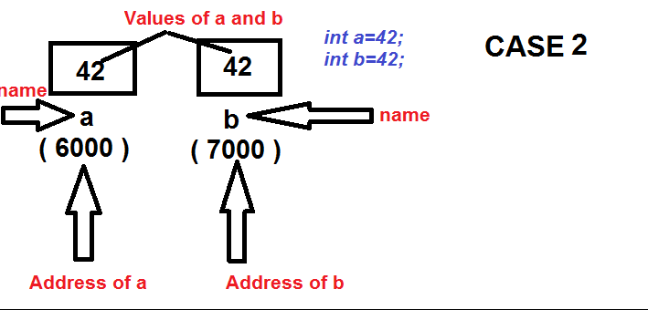
How Variables Work In C ?
Now if we declare another variable , with the same value , then again the same process will take place.
Suppose we write , int b=42;

Slide 6
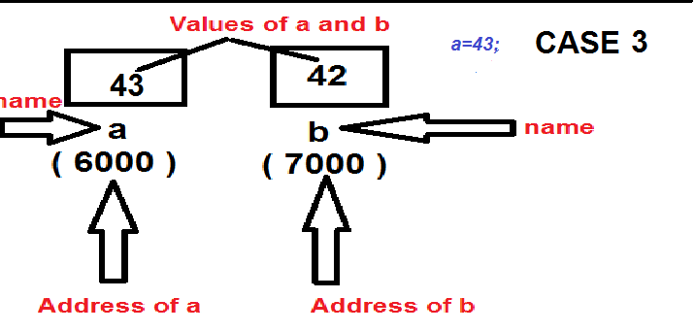
How Variables Work In C ?
Finally if we assign a new value to an existing variable , then it’s previous value gets overwritten
Suppose we write , a=43;

Slide 7
How Variables Work In Python ?
In Python when we assign value to a variable , then things are different than C .
Suppose we write a=42 in Python , then Python will create 2 things:
An object in heap memory holding the value 42 ,
and
A reference called a which will point to this object

Slide 8
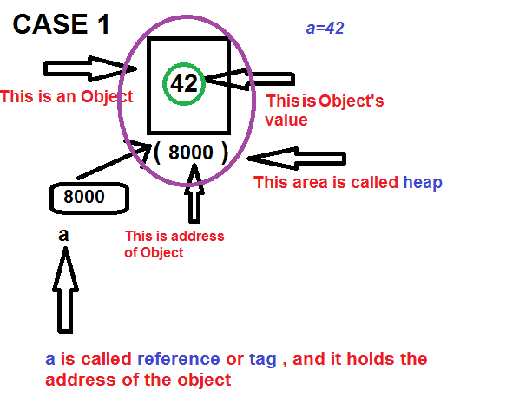
How Variables Work In Python ?

Slide 9
How Variables Work In Python ?
Now if we create another variable called b and assign it the same value , then Python will do the following:
Create a new reference by the name b
Assign the address of the previously created object to the reference b because the value is same
So now both a and b are pointing to the same object

Slide 10
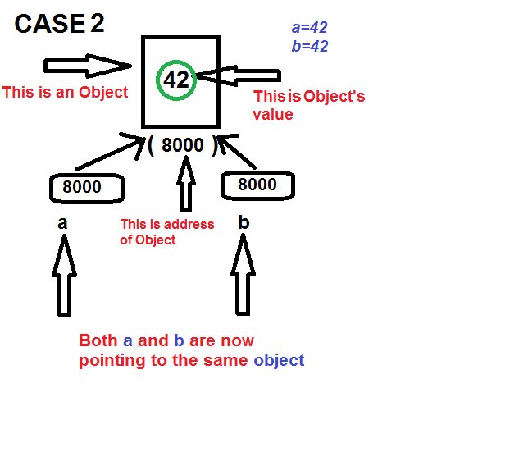
How Variables Work In Python ?

Slide 11
How Variables Work In Python ?
Finally if we assign a new value to the variable a , then like C , Python will not overwrite the value . Rather it will do the following:
Create a new object initialized with the new value
Assign the address of the newly created object to the reference a
However the reference b is still pointing to the same object

Slide 12
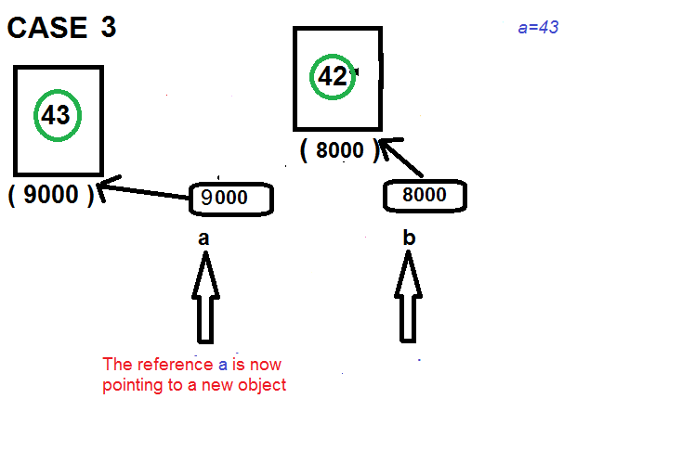
How Variables Work In Python ?

Slide 13
How Variables Work In Python ?
This behaviour of objects in Python is called “immutability”
In other words when we cannot change the value of an object , we say it is immutable , otherwise we say it is mutable
Objects of built-in types like (int, float, bool, str, complex , tuple) are immutable.
Objects of built-in types like (list, set, dict) are mutable.

Slide 14
Strings Are Also Immutable
String objects in Python are also immutable.
That is , once we have created a String object , then we cannot overwrite it’s value.
Although we can change the value of the String reference by assigning it new String.

Slide 15
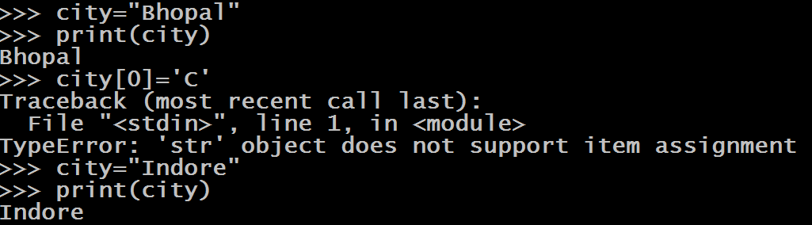
Strings Are Also Immutable

Slide 16
Immutable And Mutable
Following data types in Python are immutable:
int
float
bool
str
tuple
complex
range
frozenset
bytes
Following data types in Python are mutable:
list
dict
set
bytearray

Slide 17
Two Very Important Questions
Keeping in mind the concept of immutability , 2 very common questions arise :
What is the benefit of making objects immutable ?
&
If we have a single reference and we create multiple objects , then wouldn’t there be memory wastage ?

Slide 18
Qn 1 : Benefit Of Immutability
The main benefit of immutability is that , it prevents unnecessary creation of new objects .
This is because if we write , the following 2 statements:
a=42
b=42
Then Python will not create 2 objects . Rather it only creates 1 object and makes both the references a and b ,refer to the same object.
This saves memory and overhead of creating multiple objects

Slide 19
Qn 2 : What About Single Reference And Multiple Objects ?
Consider the following 3 lines :
a=10
a=20
a=30
When the above 3 lines will run , then Python will create 3 objects , one by one and finally the reference a will refer to the last object with the value 30
An obvious question arises , that what will happen to the previous 2 objects with the value 10 and 20 ?

Slide 20
Three Important Terms
Before understanding , what will happen to the previous 2 objects , we need to understand 3 important terminologies:
Garbage Block
The Garbage Collection
Reference Counting

Slide 21
The Garbage Block
In Python , if an object is not being referred by any reference , then such objects are called Garbage Blocks.

Slide 22
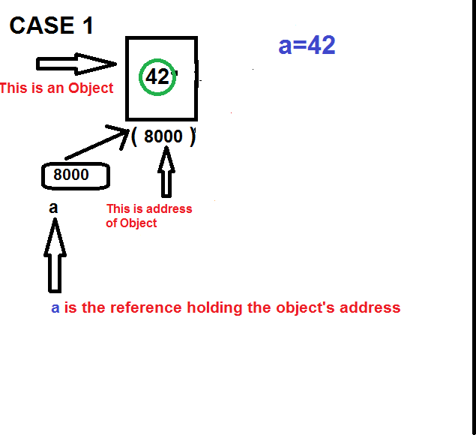
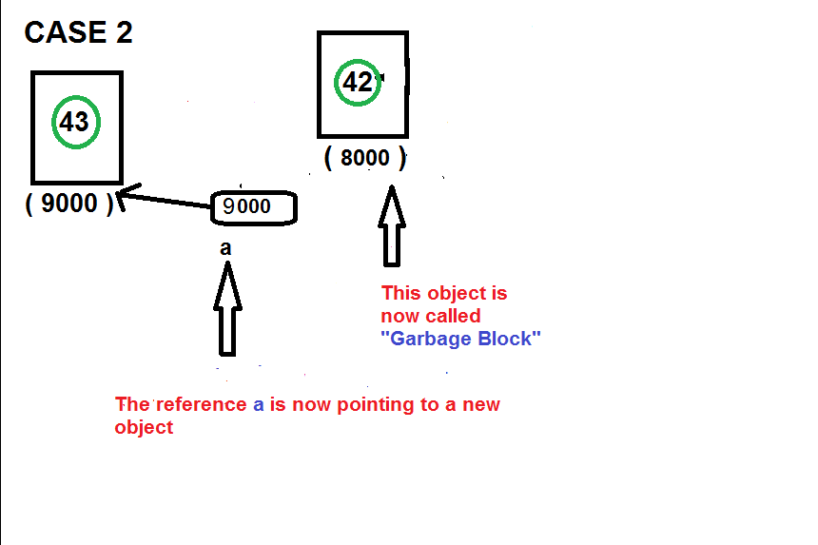
The Garbage Block

Slide 23
The Garbage Collection
Garbage collection is the process of cleaning the computer memory which was used by a running program when that program no longer needs that memory .
Garbage collection is a memory management feature in many programming languages.

Slide 24
Reference Counting
The process of memory management in Python is straightforward.
Python handles it’s objects by keeping a count to the number of references each object has in the program.
In simple words it means, each object stores how many references are currently referring it.

Slide 25
Reference Counting
This count is updated with the program runtime and when it reaches 0, this means it is not reachable from the program anymore.
Hence, the memory for this object can be reclaimed and be freed by the interpreter.

Slide 26
Reference Counting
a=10 // The object 10 has a reference count of 1
b=10 // Now 10 has reference count of 2
a=20 // Now reference count of 10 becomes 1
b=20 // Finally reference count of 10 becomes 0
As soon as the reference count of 10 becomes 0 , Python automatically removes the object 10 from memory

Slide 27
Reference Counting
So in our example
a=10
a=20
a=30
The objects 10 and 20 will be reclaimed by the Python Garbage Collector as soon as their reference count becomes 0

Slide 28
Reference Counting
ADVANTAGE:
The main advantage of such approach is that unused memory is reclaimed and made available for use again.
DISADVANTAGE:
The drawback is that Python has to continuously watch the reference count of objects in the background and free them as soon as reference count becomes 0.
This is another important reason why Python is slow as compared to other languages

Slide 29
Another Important Question
Consider the following statements:
a=42
b=42
Can you tell how many objects has Python created in the above code ?
Answer: Only 1
But , what is the proof ?

Slide 30
Another Important Question
We can prove this in 2 ways:
By using id( ) function
By using is operator

Slide 31
The id( ) Function
id() is a built-in function in Python 3, which returns the identity of an object.
The identity is a unique integer for that object during it’s lifetime.
This is also the address of the object in memory.

Slide 32
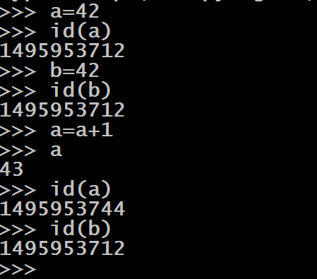
The id( ) Function
We can use the id( ) function to prove that whenever we assign the same value to a variable then Python simply assigns the address of existing object to the new reference.

Slide 33
The is Operator
Another way to find out whether 2 references are pointing to the same object or not is to use the is operator.
The is operator is a binary operator and checks whether both the operands refer to the same object or not.

Slide 34
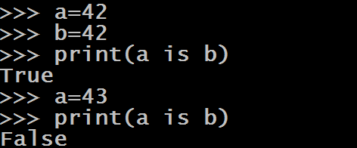
The is Operator

Slide 35
An Important Twist !
Example:
a=256
b=256
print(a is b)
Output:
True
Example:
a= -5
b=-5
print(a is b)
Output:
True

Slide 36
An Important Twist !
Example:
a=257
b=257
print(a is b)
Output:
False
Example:
a= -6
b=-6
print(a is b)
Output:
False
Python caches the integer values in the range -5 to 256 .
Beyond this range Python creates new objects even for the same value

Slide 37
Another Important Twist !
Example:
a=False
b=False
print(a is b)
Output:
True
Example:
a= “Bhopal”
b=“Bhopal”
print(a is b)
Output:
True

Slide 38
Yet Another Important Twist !
Example:
a=(2+3j)
b=(2+3j)
print(a is b)
Output:
False
Example:
a= 1.0
b=1.0
print(a is b)
Output:
False
The concept of caching or object reusability applies to strings and booleans but doesn’t apply to float and complex data types

